Slide 1
Generative Adversarial Nets Ian J. Goodfellow∗, Jean Pouget-Abadie†, Mehdi Mirza, Bing Xu, David Warde-Farley, Sherjil Ozair‡, Aaron Courville, Yoshua Bengio§
Bobo Jiang
Institute of High Performance Computing
Follow-bobo AI workshop No. 12
WeChat Official Account: follow_bobo

Slide 2
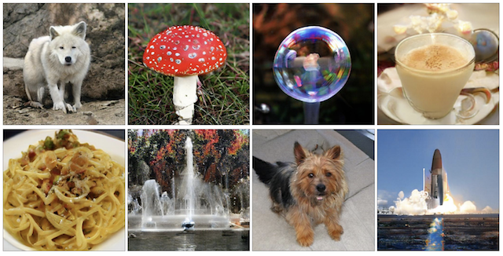
What does BigGAN generate?
Can you find what is real and what is fake?

Slide 3
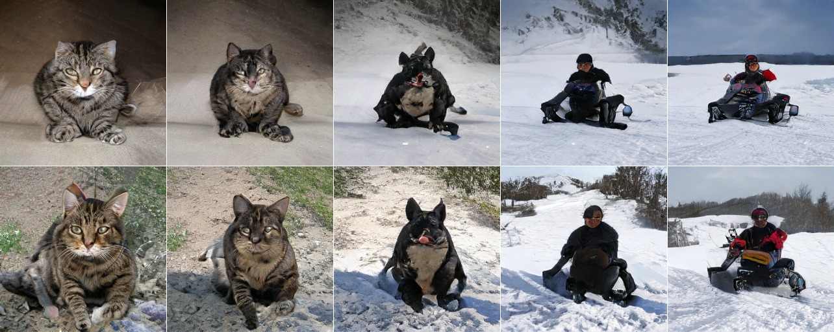
How does BigGan convert a input to a fake image?

Slide 4
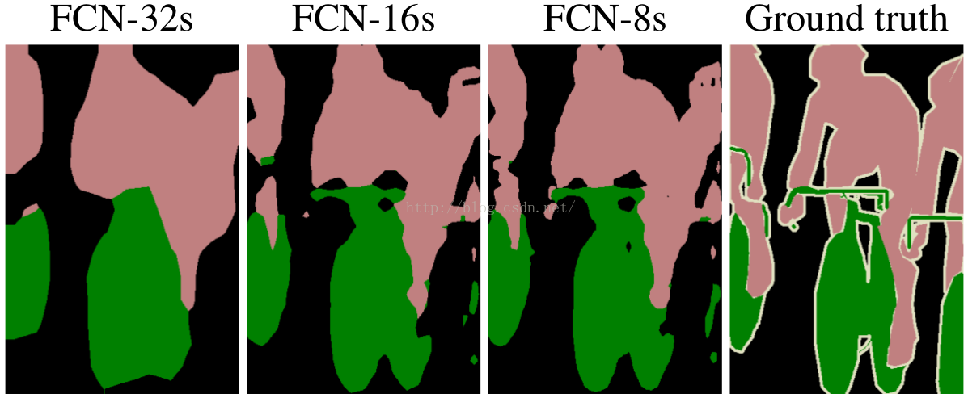
Before GAN, let us think about Segmentation?
Does network classify pixel by pixel?
The generation model mainly builds the structure of the data and captures the relationship between different dimensions of the data.

Slide 5
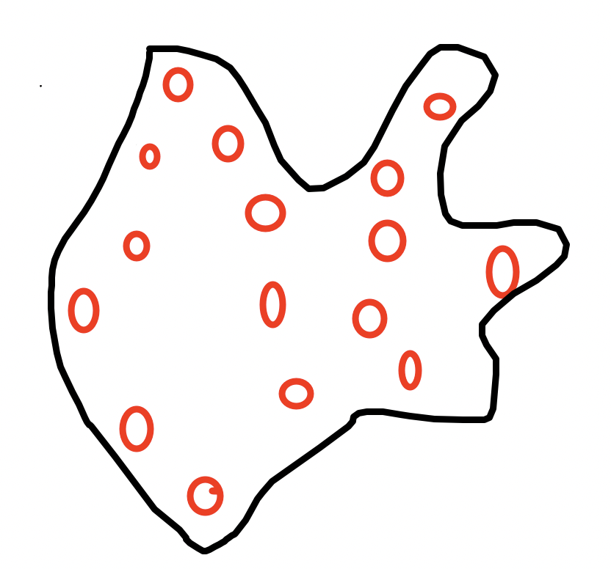
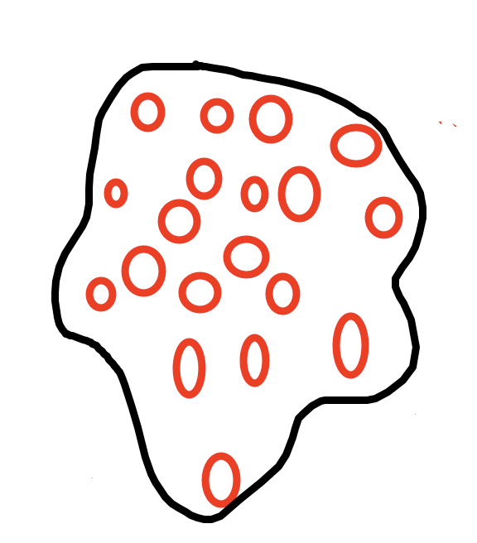
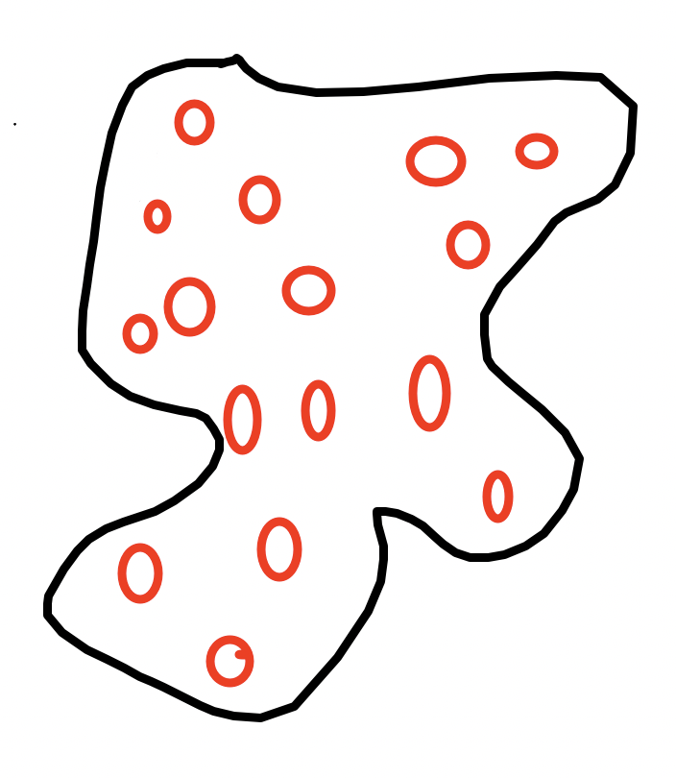
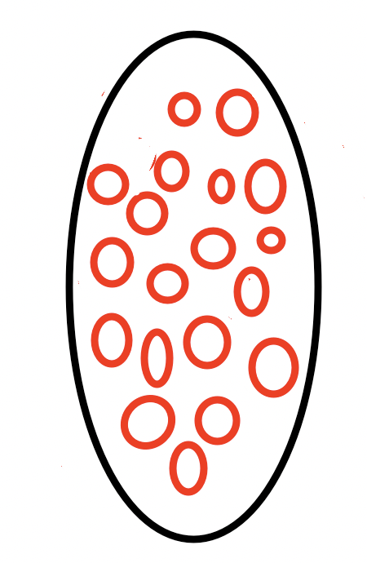
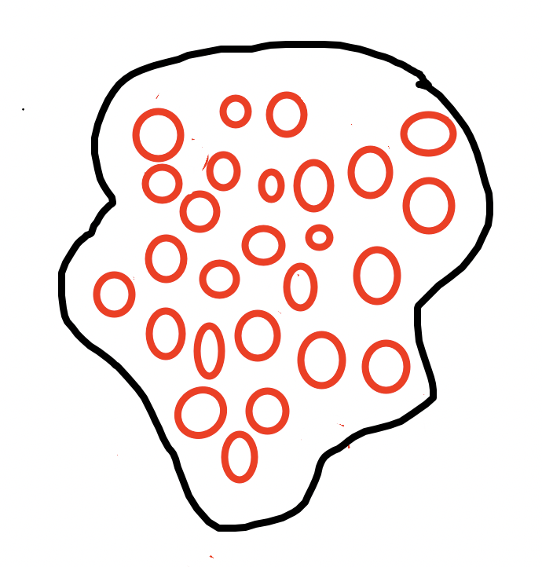
Before GAN, let us think about Segmentation?

Slide 6
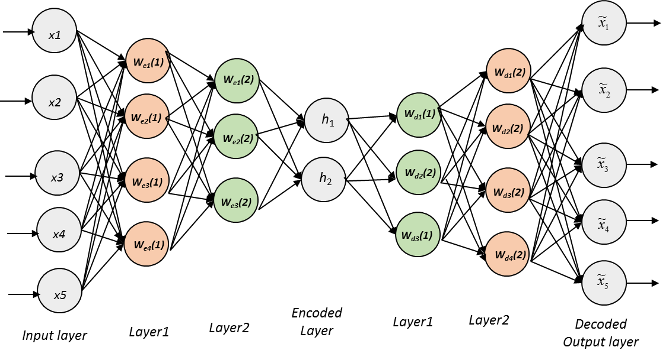
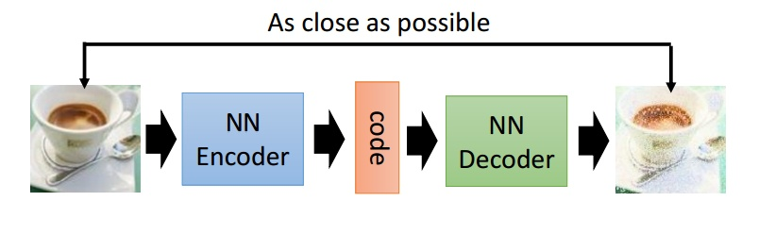
What is autoencoder - decoder?
https://magenta.tensorflow.org/assets/sketch_rnn_demo/index.html
recover features to ground truth as close as possible
let us give it another name: Generator Pg(x)
extract features
features representation and structure of the data

Slide 7
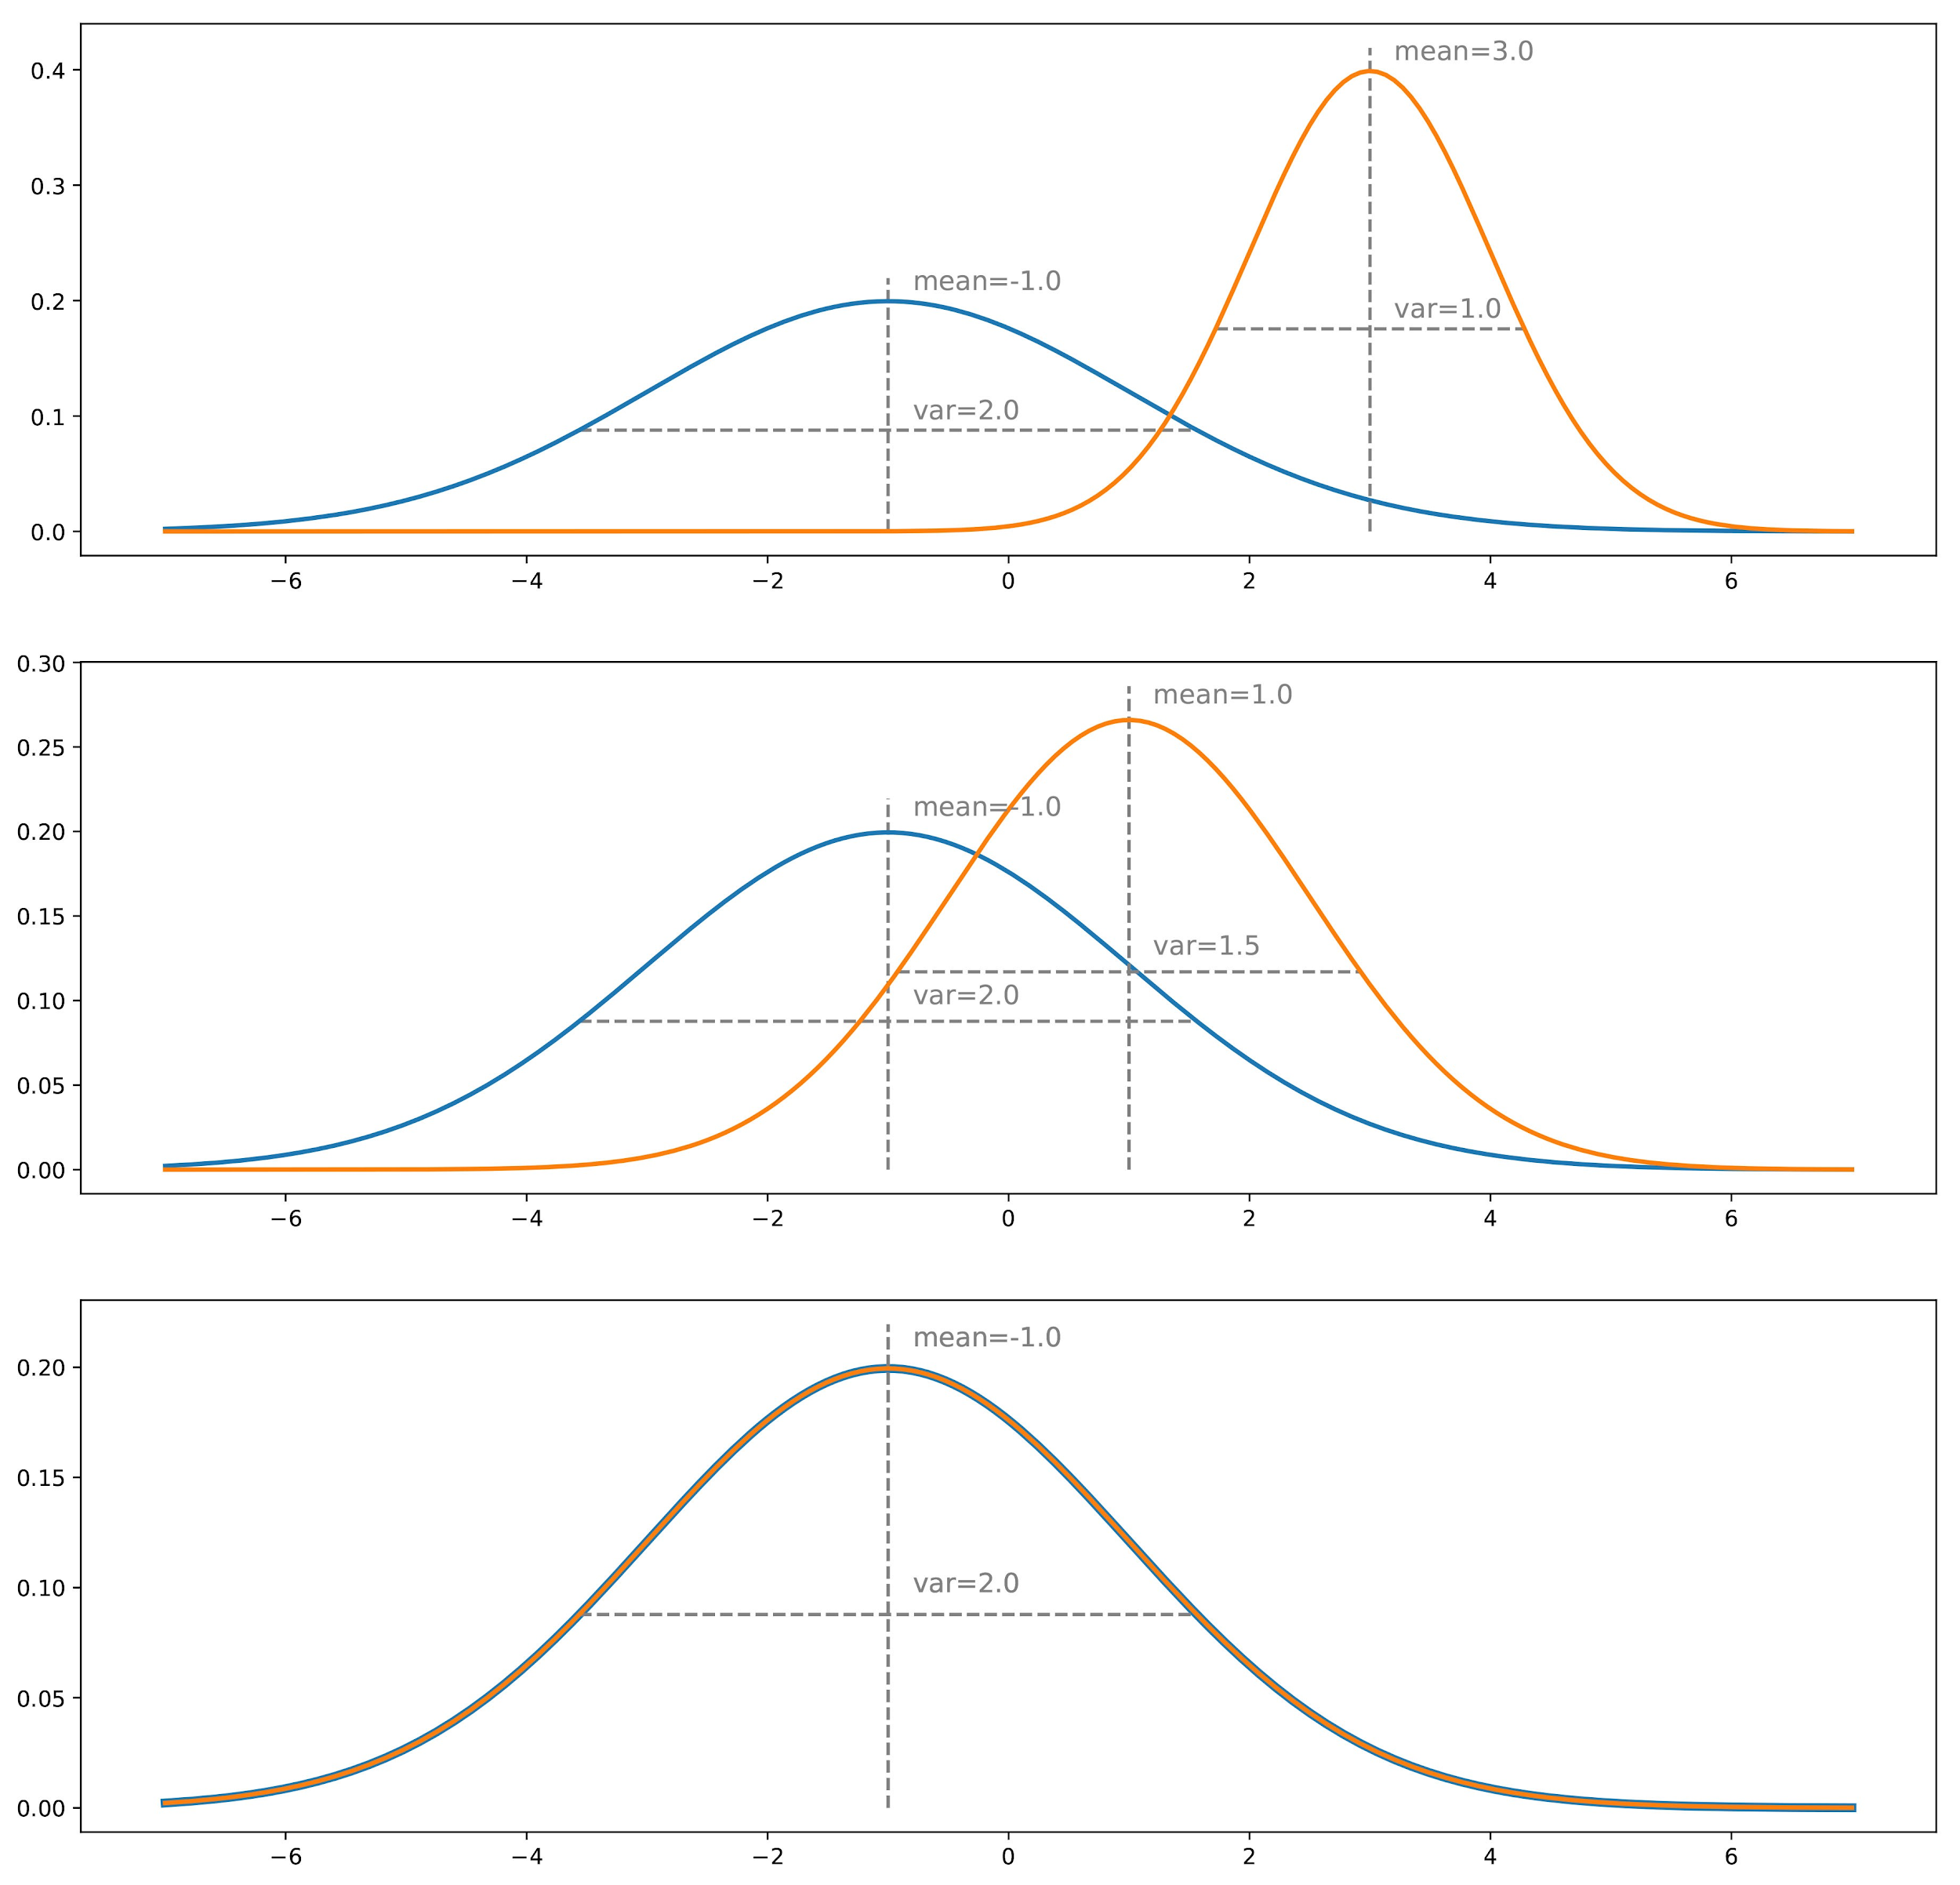
What is autoencoder - decoder?
generated image feature structure Gz(Xi, mean, std)
ground Truth image feature structure Gdata(Xi, mean, std)

Slide 8
Is there a classifier can recognize fake and real?
fake image classification score is 0
real image classification score is 1.0
fake image classification score is 0.3
fake image classification score is 0.6

Slide 9
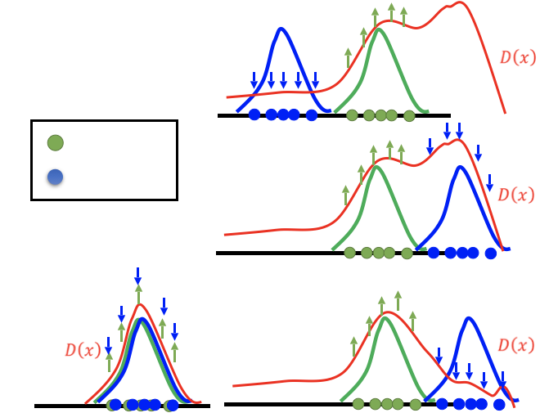
Is there a classifier can recognize fake and real?
Actully it is just a simple binary classifier,let us just call it Discriminator D(x)

Slide 10
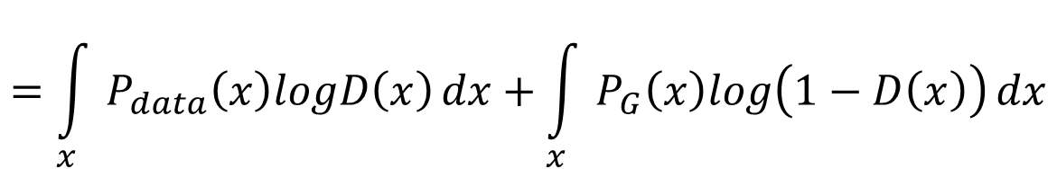
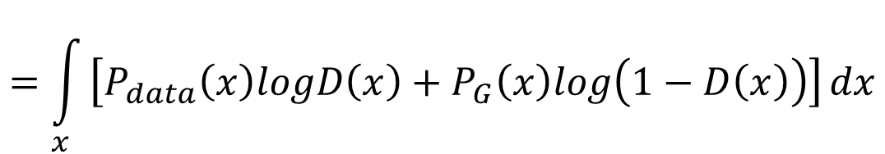
How to train Discriminator D(X)?
Given G, what is the optimal D* maximizing

Slide 11
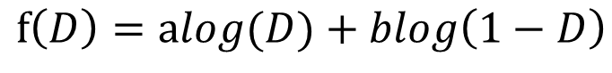
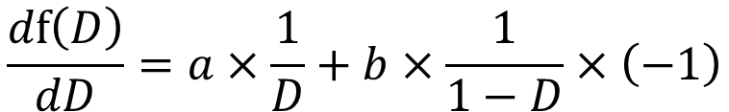
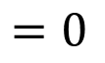
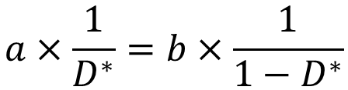
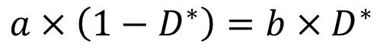
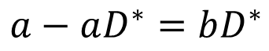
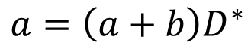
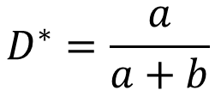
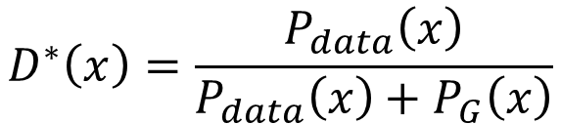
How to train Discriminator D(X)?
Binary classification object f(D):
Given x, the optimal D* maximizing
a
D
b
D
0 <
< 1

Slide 12
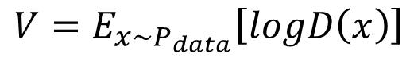
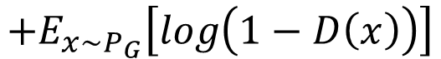
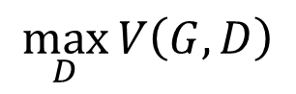
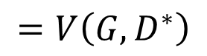
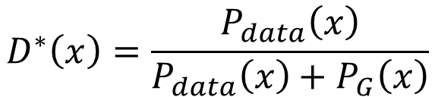
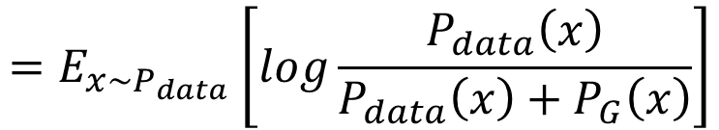
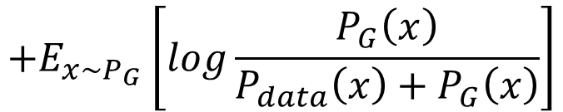

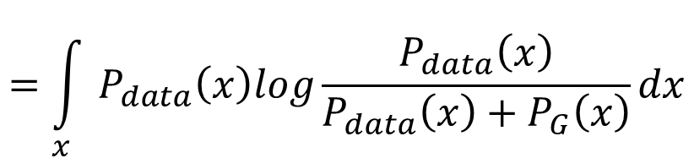

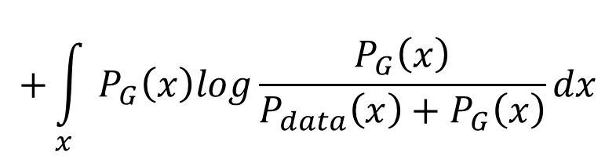

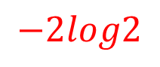
How to train Discriminator D(X)?
2
2

Slide 13
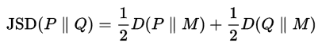
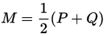
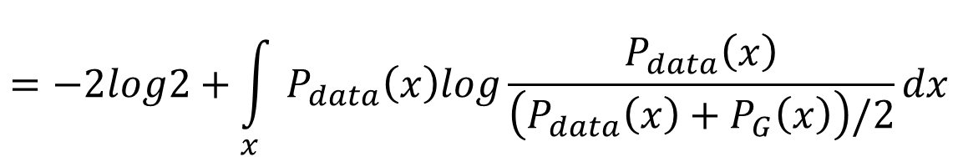
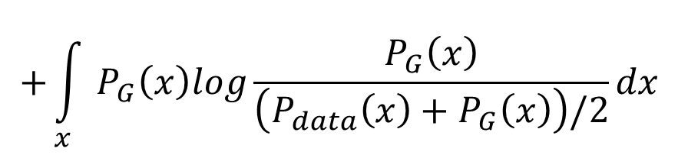
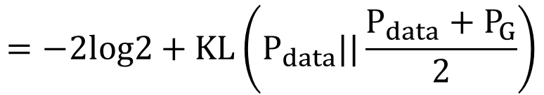
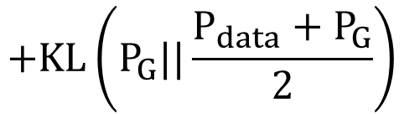
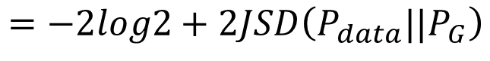
How to train Discriminator D(X)?
Jensen-Shannon divergence

Slide 14
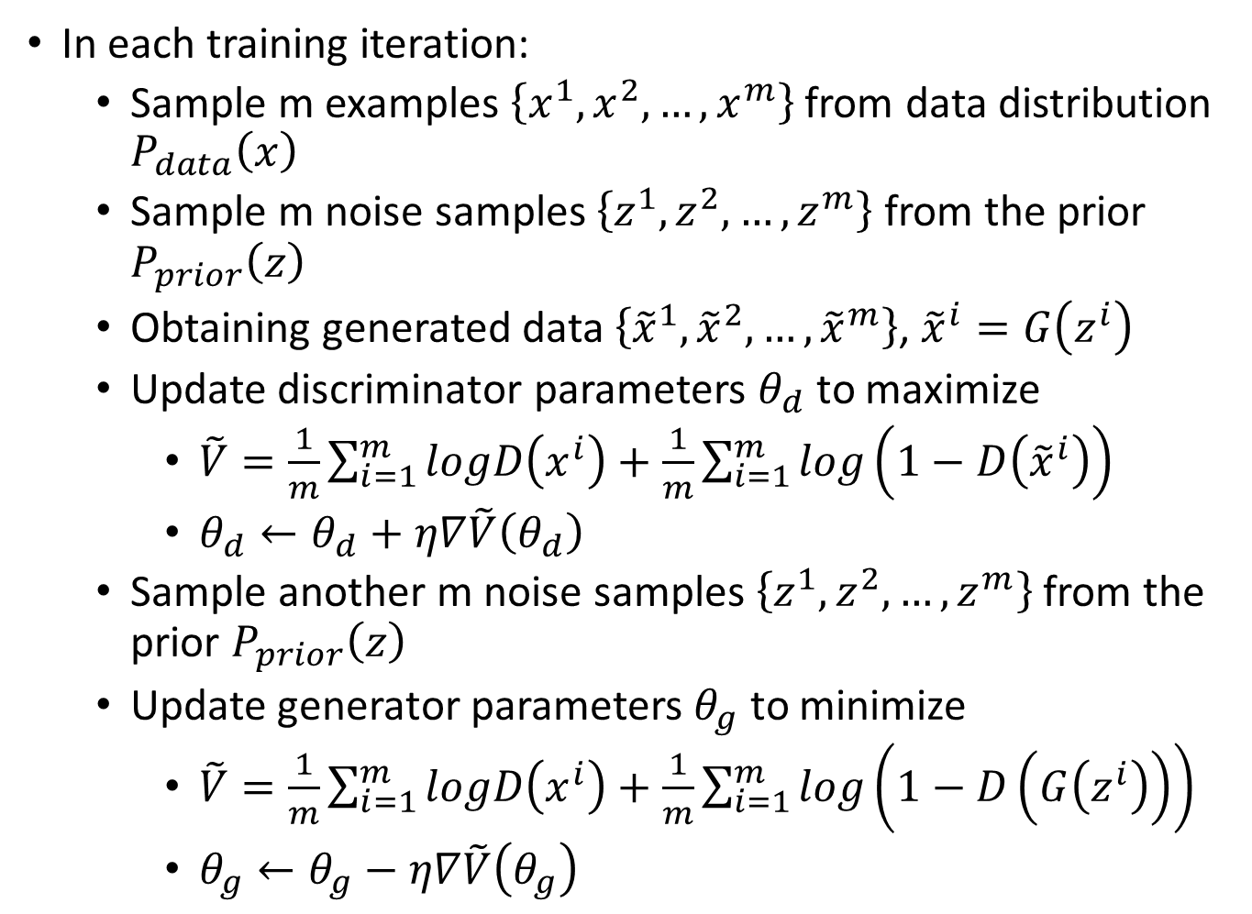
How to train Discriminator D(X)?
Learning
D
Repeat k times

Slide 15
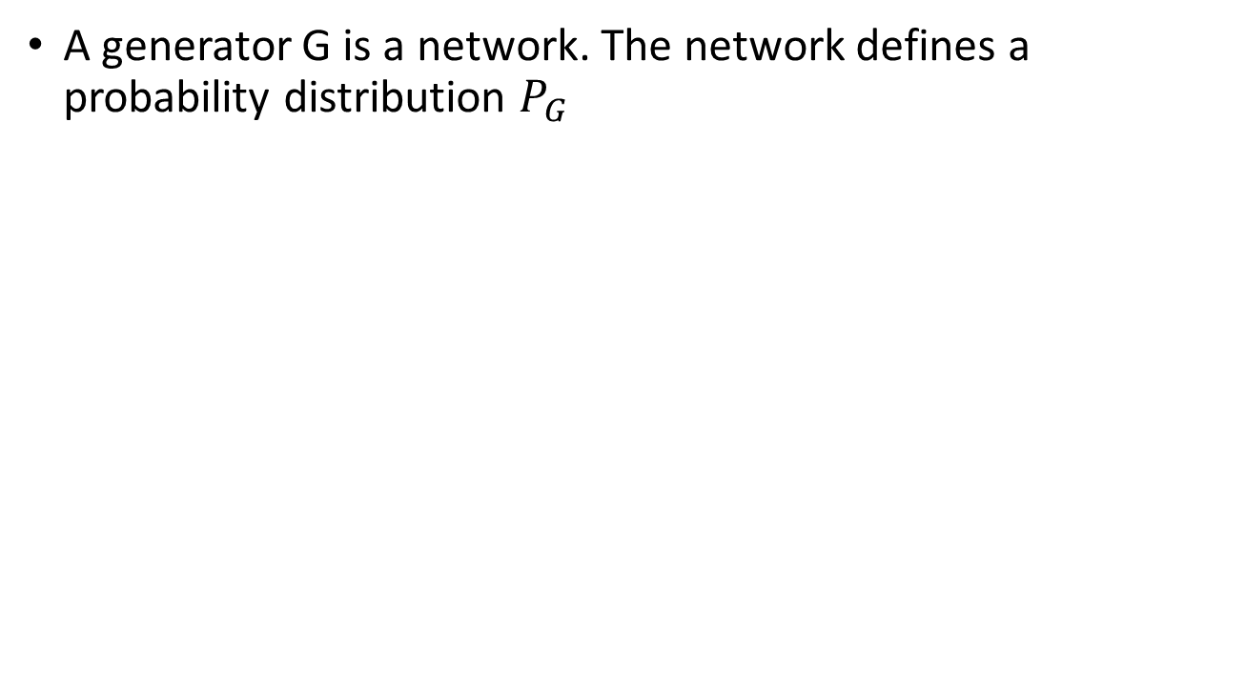
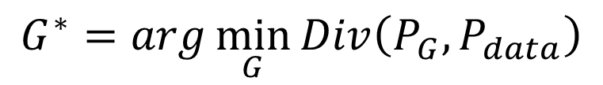
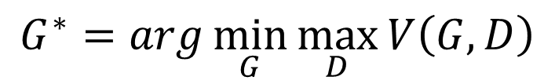
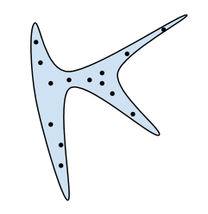
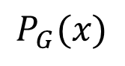


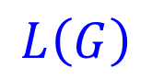

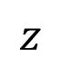
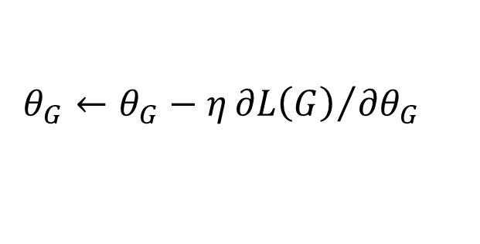
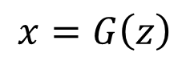


How to train Generator D(X)?
Input
generator
G
as close as possible
How to compute the divergence?

Slide 16







How to train Generator G(X)?
smaller
When you train generator, only train several epochs each time, like 1 or 2 , to make G(x) doesn’t change too much

Slide 17
Reference
[1] Radford A, Metz L, Chintala S. Unsupervised representation learning with deep convolutional generative adversarial networks[J]. arXiv preprint arXiv:1511.06434, 2015.
[2] 李宏毅课件http://speech.ee.ntu.edu.tw/~tlkagk/courses_MLDS18.html

Slide 18
关注公号：follow_bobo， 加入机器学习交流群

